Slide 1
Artificial neural networks (ANN)
By Dr. Ali Saeed

Slide 2
Introduction
Artificial neural networks (ANN) or connectionist systems are computing systems vaguely inspired by the biological neural networks that constitute animal brains.
Such systems "learn" to perform tasks by considering examples, generally without being programmed with task-specific rules.

Slide 3
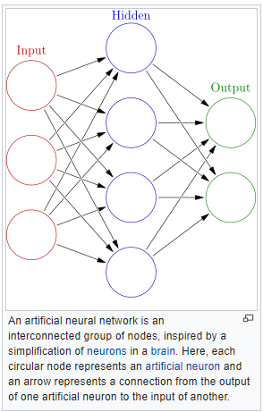
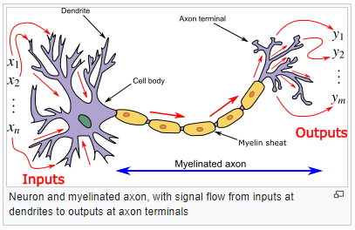
Comparison pictures

Slide 4
What is a perceptron
The simplest form of a neural network consists of a single neuron with adjustable synaptic weights and bias performs pattern classification with only two classes
perceptron convergence theorem :
  Patterns (vectors) are drawn from two linearly separable classes
  During training, the perceptron algorithm converges and positions the decision surface in the form of hyperplane between two classes by adjusting synaptic weights

Slide 5
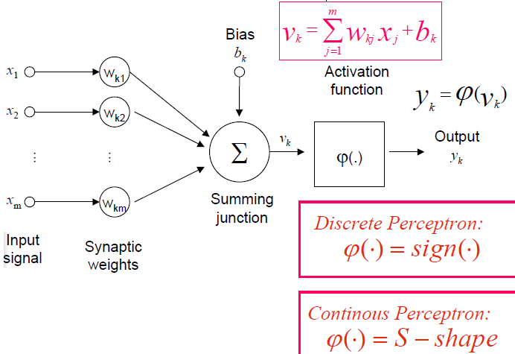
What is a perceptron?
10
12
3
0.8
1.4
-0.4
0.2

Slide 6
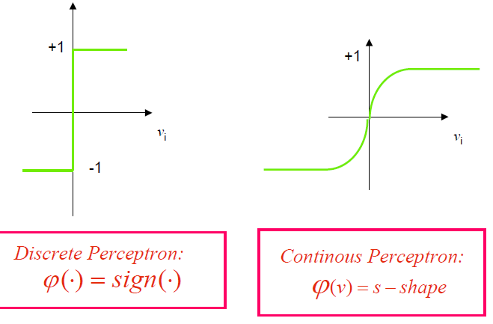
SoftMax, Tanh, Sigmoid, Step, ReLU

Slide 7
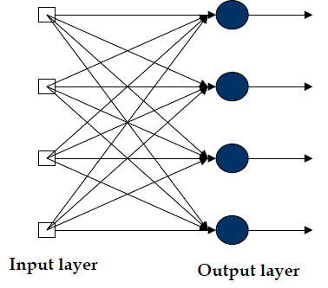
Single layer perceptron

Slide 8
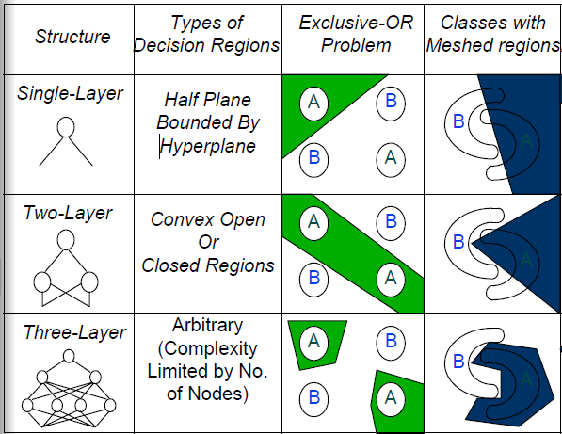
Different Non-Linearly Separable Problems

Slide 9
Y y y
X x x x
X x y y
X x
X y y y y
y y y
x x x x

Slide 10
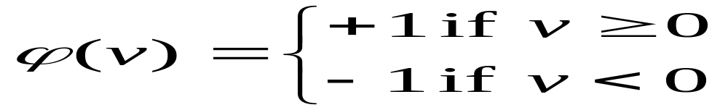
Perceptron: Neuron Model
(Special form of single layer feed forward)
The perceptron was first proposed by Rosenblatt (1958) is a simple neuron that is used to classify its input into one of two categories.
A perceptron uses a step function that returns +1 if weighted sum of its input ≥ 0 and -1 otherwise
b (bias)
x₁
w₁
v
y
x₂
w₂
ϕ(v)
w_{n}
x_{n}

Slide 11
Perceptron for Classification
The perceptron is used for binary classification.
First train a perceptron for a classification task.
  Find suitable weights in such a way that the training examples are correctly classified.
  Geometrically try to find a hyper-plane that separates the examples of the two classes.
The perceptron can only model linearly separable classes.
When the two classes are not linearly separable, it may be desirable to obtain a linear separator that minimizes the mean squared error
Given training examples of classes C₁, C₂ train the perceptron in such a way that :
  If the output of the perceptron is +1 then the input is assigned to class C₁
  If the output is -1 then the input is assigned to C₂

Slide 12
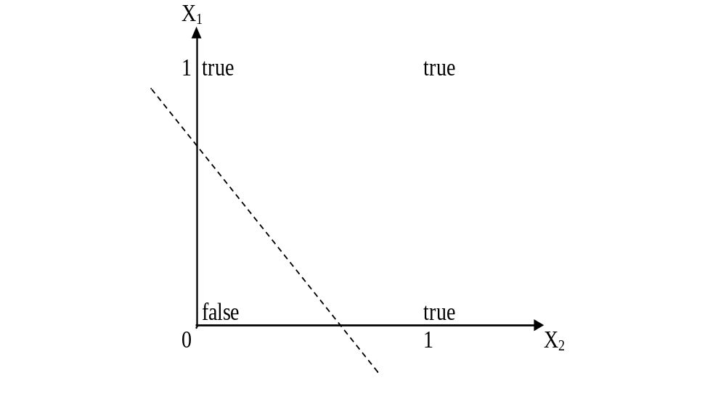
Boolean function OR – Linearly separable
(1,0)
(1,1)
-0.2
X1=0
Y=0
X2=0
0.4
(0,1)
(0,0)

Slide 13
X
X x x x x y y y
X x xy y y y
Y y y
y
X x
y y y y y
Y
Yy y y y
Yy y x x x
Y y x x x x
?
Wi=0.7
a= -0.001
Xi=1
E=1
wi ← wi + (a* xi *e)

Slide 14
Learning Process for Perceptron
Initially assign random weights to inputs between -0.5 and +0.5
Training data is presented to perceptron and its output is observed.
If output is incorrect, the weights are adjusted accordingly using following formula.
wi ← wi + (a* xi *e), where ‘e’ is error produced and ‘a’ (-1 < a < 1) is learning rate
  ‘a’ is defined as 0 if output is correct, it is +ve, if output is too low and –ve, if output is too high.
  Once the modification to weights has taken place, the next piece of training data is used in the same way.
  Once all the training data have been applied, the process starts again until all the weights are correct and all errors are zero.
  Each iteration of this process is known as an epoch.

Slide 15
Example: Perceptron to learn OR function
Initially consider w1 = -0.2 and w2 = 0.4
Training data say, x1 = 0 and x2 = 0, output is 0.
Compute y = Step(w1*x1 + w2*x2) = 0. Output is correct so weights are not changed.
For training data x1=0 and x2 = 1, output is 1
Compute y = Step(w1*x1 + w2*x2) = 0.4 = 1. Output is correct so weights are not changed.
Next training data x1=1 and x2 = 0 and output is 1
Compute y = Step(w1*x1 + w2*x2) = - 0.2 = 0. Output is incorrect, hence weights are to be changed.
Assume a = 0.2 and error e=1
wi = wi + (a * xi * e) gives w1 = 0 and w2 =0.4
With these weights, test the remaining test data.
Repeat the process till we get stable result.

Slide 16
Perceptron: Limitations
The perceptron can only model linearly separable functions,
  those functions which can be drawn in 2-dim graph and single straight line separates values in two part.
Boolean functions given below are linearly separable:
  AND
  OR
  COMPLEMENT
It cannot model XOR function as it is non linearly separable.
  When the two classes are not linearly separable, it may be desirable to obtain a linear separator that minimizes the mean squared error.

Slide 17
XOR – Non linearly separable function
A typical example of non-linearly separable function is the XOR that computes the logical exclusive or..
This function takes two input arguments with values in {0,1} and returns one output in {0,1},
Here 0 and 1 are encoding of the truth values false and true,
The output is true if and only if the two inputs have different truth values.
XOR is non linearly separable function which can not be modeled by perceptron.
For such functions we have to use multi layer feed-forward network.

Slide 18
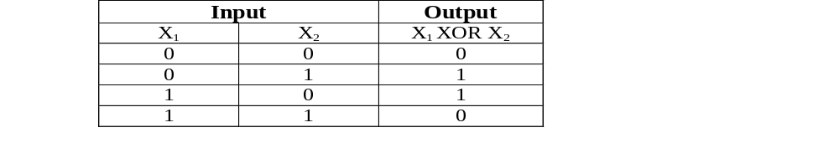
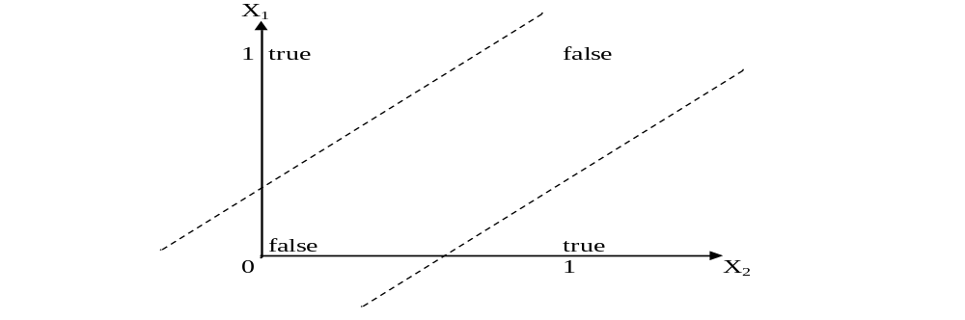
These two classes (true and false) cannot be separated using a line. Hence XOR is non linearly separable.

Slide 19
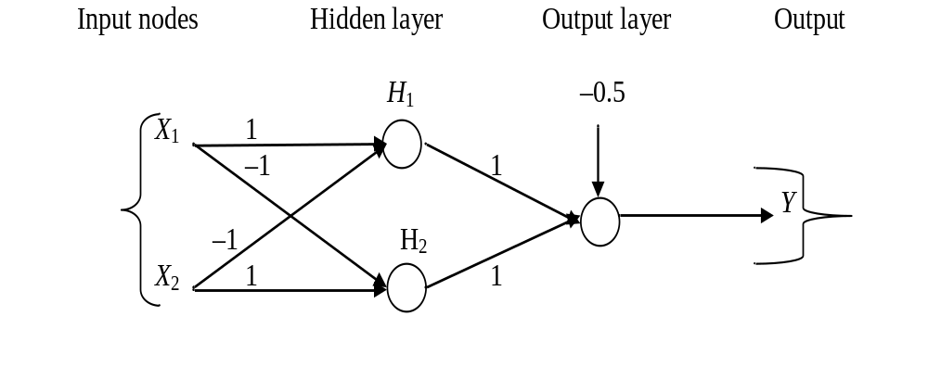
NN for XOR
The ANN for XOR has two hidden nodes that realizes this non-linear separation and uses the sign (step) activation function.
Arrows from input nodes to two hidden nodes indicate the directions of the weight vectors (1,-1) and (-1,1).
The output node is used to combine the outputs of the two hidden nodes.

Slide 20
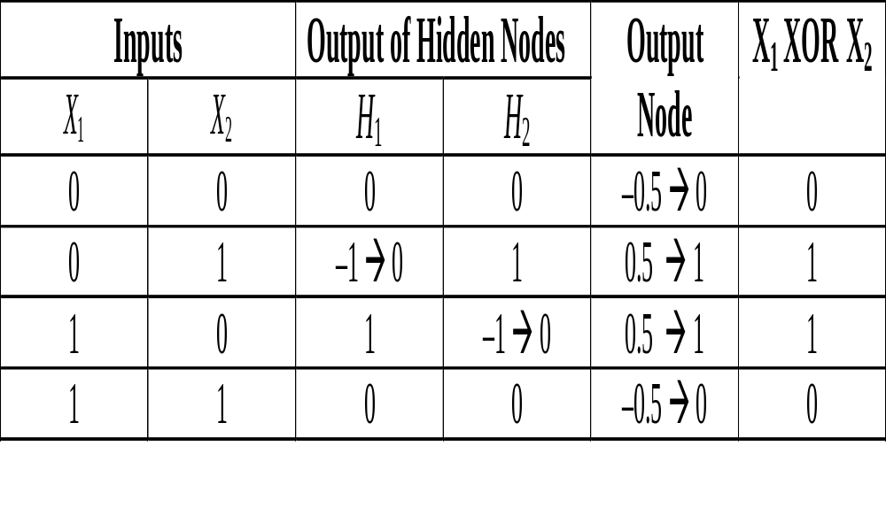
Since we are representing two states by 0 (false) and 1 (true), we will map negative outputs (–1, –0.5) of hidden and output layers to 0 and positive output (0.5) to 1.

Slide 21
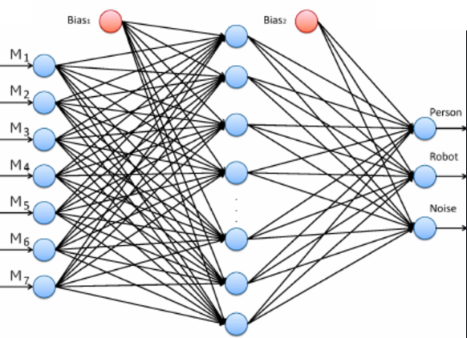
Feed Forward NN
Feed-forward ANNs allow signals to travel one way only: from input to output.
Also known as Multi-Layered Perceptron
There are no feedback (loops); i.e., the output of any layer does not affect that same layer.
Feed-forward ANNs tend to be straightforward networks that associate inputs with outputs.
They are extensively used in pattern recognition. This type of organisation is also referred to as bottom-up or top-down

Slide 22
Feed BackNN
Feedback (or recurrent or interactive) networks can have signals traveling in both directions by introducing loops in the network.
Feedback networks are powerful and can get extremely complicated. Computations derived from earlier input are fed back into the network, which gives them a kind of memory.
Feedback networks are dynamic; their 'state' is changing continuously until they reach an equilibrium point.
They remain at the equilibrium point until the input changes and a new equilibrium needs to be found

Slide 23
Thanks
Questions?

